Slide 1
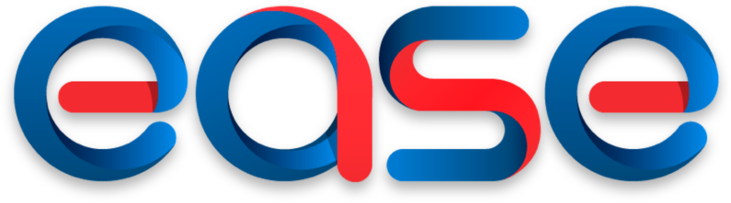
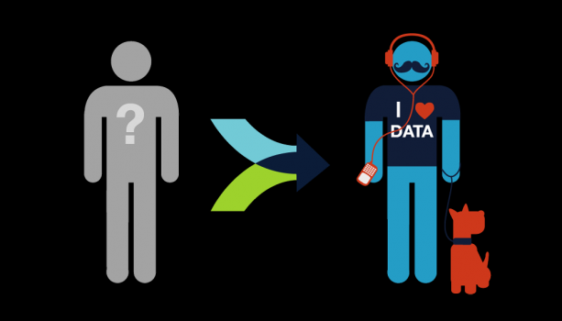
Personalizing
Personalizing
COF

Slide 2
Executive Summary
OPPORTUNITY
APPROACH
Customer expectations for personalized banking experiences are increasingly being shaped by digital giants, fintech, and competitors, especially among Millennials
A cohesive Personalization strategy can create sustained, authentic customer engagement that leads to measurable and impactful business results
Capital One has not achieved its potential for customer and digital engagement, limiting our ability to achieve cost/ revenue targets
While we have some key pieces in place, we need investment to deliver breakout results

Slide 3
Agenda
Define Personalization
Outline Business Opportunity
Define EASE Approach
Outline Capabilities Needed
Where We Start

Slide 4
What is Personalization?
…and why should Capital One pursue it?

Slide 5
Personalization (in the context of experiences) is a multi-faceted concept
What is personalization?
How do we experience it?
“An experience that uses customer data and understanding to frame, guide, extend, and enhance interactions based on that person's history, preferences, context, and intent.”
- Forrester, “Pivot to Person First Personalization”
How is it useful?
Customizations
Personalized content
Recommendations/ advice
Contextual/ relevant info
Proactive/ predictive alerts
Adaptive/ learned UX
Generate business results
Direct positive customer behavior change
Evoke positive emotions

Slide 6
Personalization effectively blends Customization and Contextualization into a cohesive experience
Customization
Allow customers to shape experience through settings, preferences, and direct feedback
Personalized UX
Display Preferences
Content Preferences
Feature Enrollment
COF Examples
Account sort order
Alert subscriptions
Autopay
Contextualization
Provide content and experiences relevant to a situation or framed to meet a need
Personalized UX
Timely Info/ Update
Contextual Recommendations
COF Examples
Harmony Campaigns
Second Look
CreditWise
Feature-Centric Agenda
Content-Centric Agenda

Slide 7





In our modern digital world, we most associate personalization as businesses using information they know about us to recommend things
Personalization Pioneers
now
What you should
buy next
What social content
you should read
What you need to
know now
What you should
watch next
What you should
hear next
Powered By
Recommendation Platform
Multiple ML Models
Lots of Connected Data
Large Content Inventory
Notes:
1 https://www.yahoo.com/tech/how-does-facebook-decide-what-shows-up-in-your-news-90375237489.html
Amazon – 100s? item-to-item collaborative filtering models drive separate queues to maximize purchasing
Pandora – Content filtering based upon Music Genome (450 attributes). TU = Play more like this/ TD = Remove song to maximize playing time
Netflix – Cinematch – Hybrid content (meta) and collaborative filtering (views, ratings) divided into content (genre, actors, character types) and mood-based queues to maximize viewing time
Facebook – Newsfeed driven by a central ranking algorithm fed from relevancy scores derived from many predictive models for each outcome (click, like/hide, share, comment) to maximize engagement
Facebook News Feed -> goal is to get the right content to the right Customers at the right time/ need to condense 1500+ stories -> 300^{1/} measure result in terms of engagement (clicks, likes/ hides, comments, shares)1

Slide 8
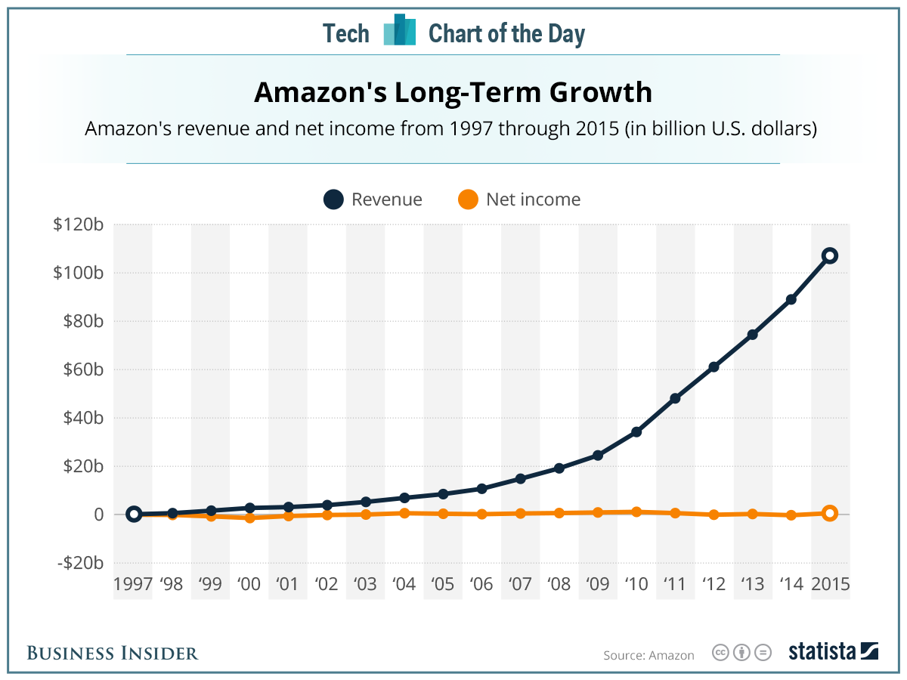
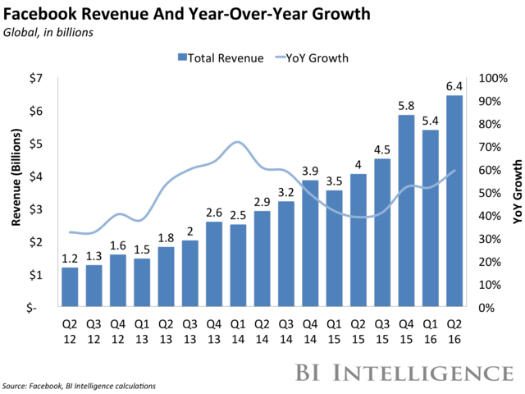
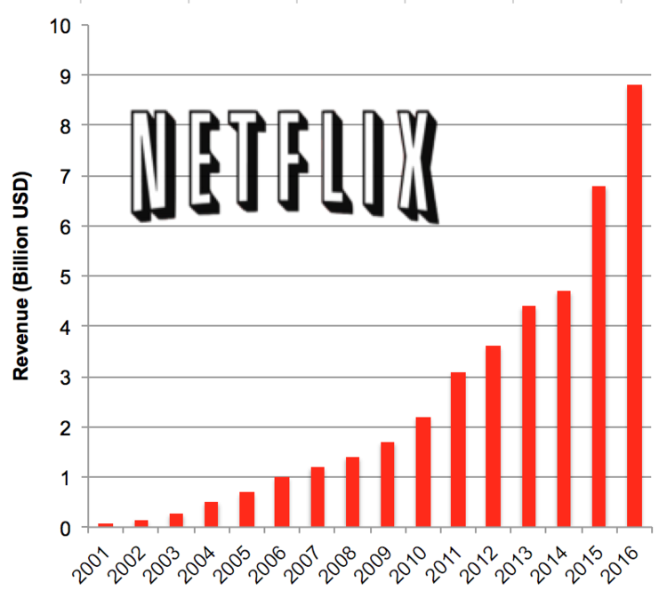
This approach to machine-driven personalization has generated real business results
Facebook has 1.23B DAUs sharing >4.75B posts, creating
$4.83 avg revenue per user ^{3, 4}
35% of Amazon’s revenue generated through personalized recommendations^{1, 2}
Netlfix recommendations drive 75% of viewing across > 89B subscribers @ 1.8hrs/day ^{4, 5, 6}
Notes:
1 http://www.mckinsey.com/industries/retail/our-insights/how-retailers-can-keep-up-with-consumers
2 https://www.martechadvisor.com/articles/customer-experience/recommendation-engines-how-amazon-and-netflix-are-winning-the-personalization-battle/
3 https://zephoria.com/top-15-valuable-facebook-statistics/
4 https://techcrunch.com/2017/02/01/facebook-q4-2016-earnings/
5 http://www.businessinsider.com/subscribers-spent-more-time-per-person-watching-netflix-in-2015-2016-1
6 https://www.usatoday.com/story/tech/news/2017/01/18/netflix-shares-up-q4-subscriber-additions/96710172/
7 http://www.newsindata.com/home/2017/1/19/netflix-surges-in-2016-comcastnot-so-much (char)

Slide 9
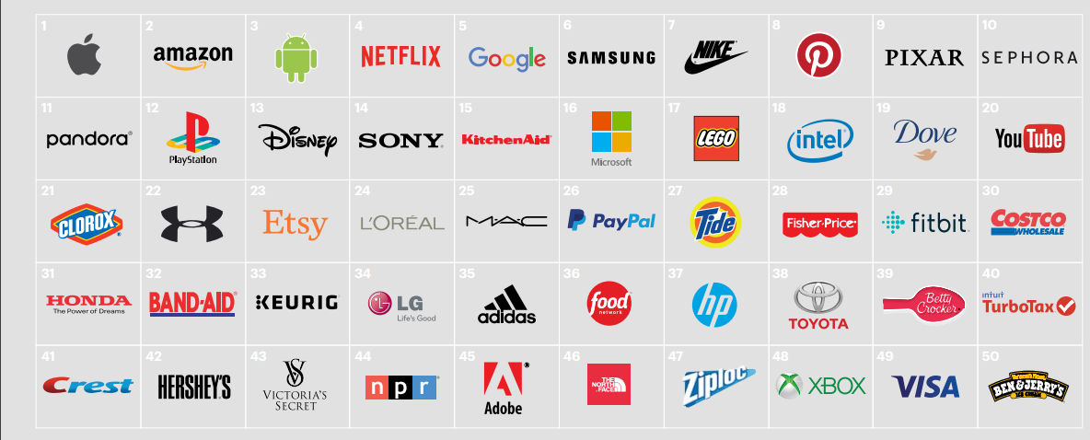
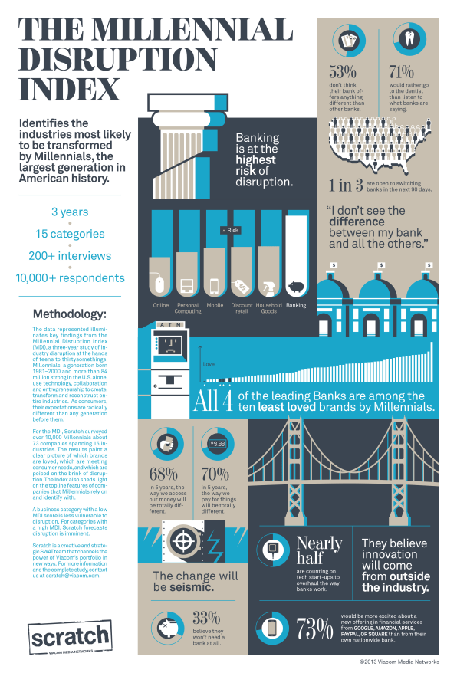
These digital personalization pioneers are among the most relevant brands and are positioned to bridge the trust gap in banking
2016 Prophet Brand Relevance Index (US)
Accenture Study
31% of consumers would be willing switch to GAFA for banking services, and a 1/3 of these said they would actively seek them out if the option was available
Personalization is 30% of what draws a person to a brand today, as opposed to only 6% in 1997.¹
⁻ Brand Keys Study
Millennial Disruption Index
Notes:
1 https://newsroom.accenture.com/news/seven-out-of-10-consumers-globally-welcome-robo-advice-for-banking-insurance-and-retirement-services-according-to-accenture.htm
2 https://www.martechadvisor.com/articles/customer-experience/recommendation-engines-how-amazon-and-netflix-are-winning-the-personalization-battle/
3 https://zephoria.com/top-15-valuable-facebook-statistics/
1 https://thefinancialbrand.com/64760/google-facebook-amazon-digital-experience/
https://www.prophet.com/relevantbrands-2016/

Slide 10
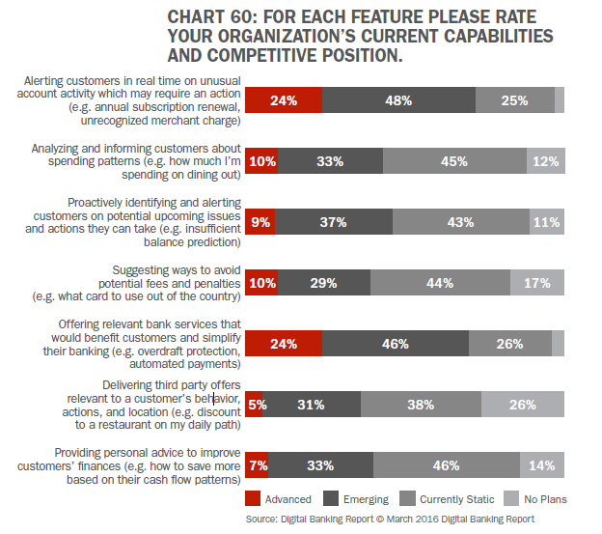
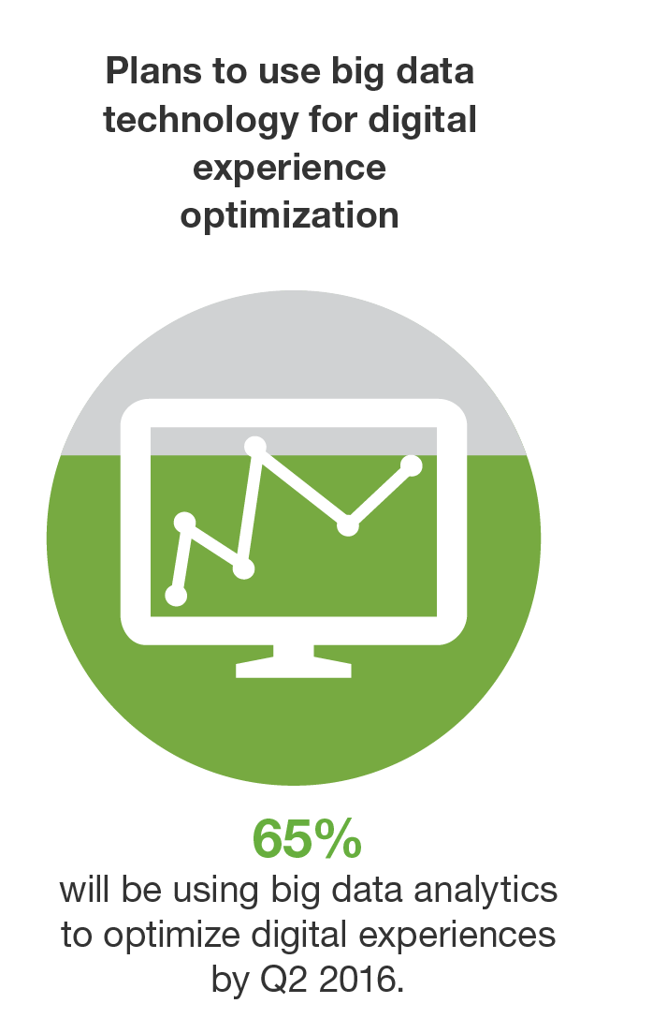
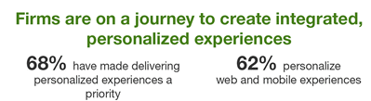
There is evidence of real investment in personalization across industries and within our own
Forrester
Digital Banking Report
Notes:
65% - Forrester’s Global Business Technographics Data and Analytics Survey, 2015
68% - Forrester’s Digital Experience Delivery Online Survey , Q1 2016
Chart 60 – Digital Banking Report “The Power of Personalization in Banking”, 2016

Slide 11
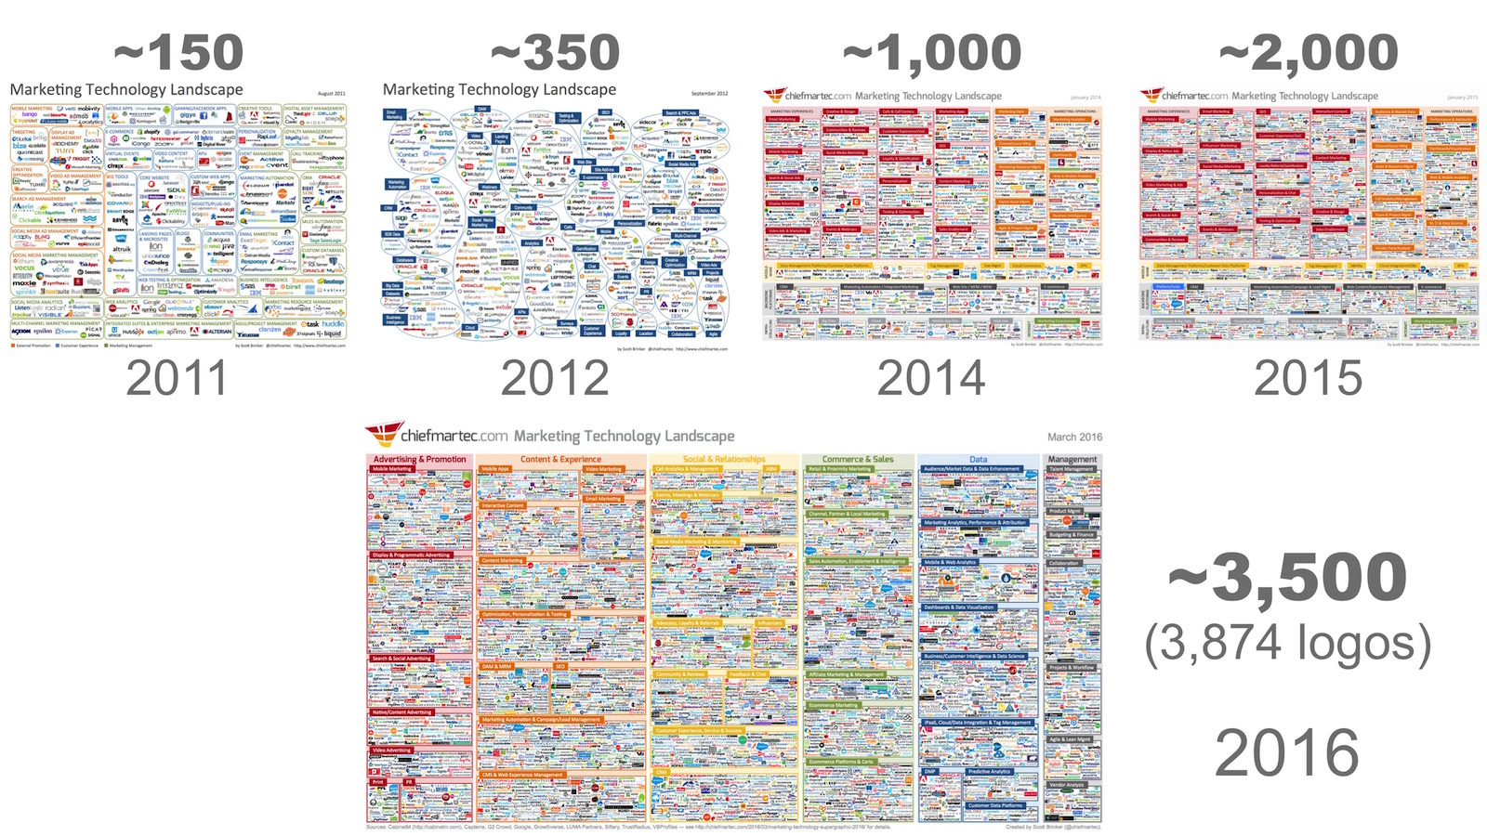
There has been an explosion in marketing technology that can be used to power personalization-type agendas
Marketing Technology Landscape

Slide 12
At Capital One, we use our digital channels to “recommend” things to our customers all of the time
Current
Emerging
Products You Need
Things You Should Know
(Service Updates)
And this is big business for us:
$ Digital-Driven Revenue & Savings
Account Servicing Actions
Things You Might Be Interested In
(Insights)
Digital Products & Features You Need
Recommended Next Step
(Onboarding)

Slide 13




Capital One’s personalization strategy will need to consider its primary business objective
Marketplace
Sell products
Sell advertising
Sell advertising
Maximize Customer Value?
Primary
Business
Objective
Simplify purchase decisions and buying process
Staying connected with friends and family
Information and tools to manage everyday life
Manage daily financial needs and achieve financial goals
Customer Need
Deliver product recommendations for every purchasing need
Foster daily/ hourly usage by sharing engaging content
Deliver relevant, contextual, and predictive content and tools
??
Personalization
Approach

Slide 14
Given the nature of our products and services, we can apply specific personalization “techniques” that have proven successful
Collaborative Filtering (Peering)
Recommend based upon response from peers - “others like you”
Collaborative Filtering (Content)
Recommend based upon content similarities – “things like this”
Feedback-Driven Customization
Recommend/ adapt based upon individual feedback and preferences
Behavior Targeting/ Learning
Recommend/ adapt based upon past behavior
Event/ State Targeting
Recommend based upon awareness of a relevant event/ state
Predictive/ Proactive
Recommend/ adapt based upon anticipation of an event
Mode/ Mood Targeting
Recommend/ adapt based upon person’s state of mind or goal
Profiling/ Surveying
Recommend by collecting specific information from the customer

Slide 15
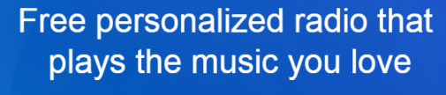
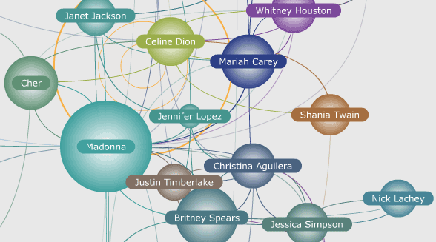

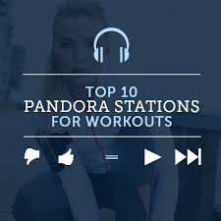
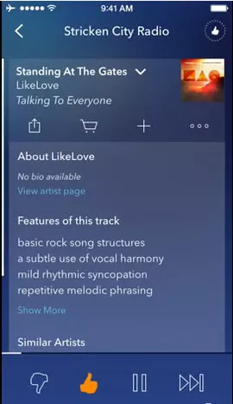
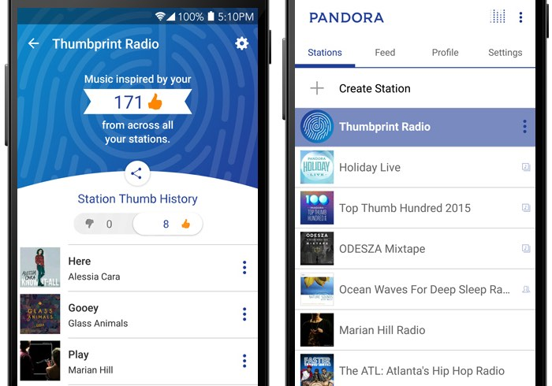
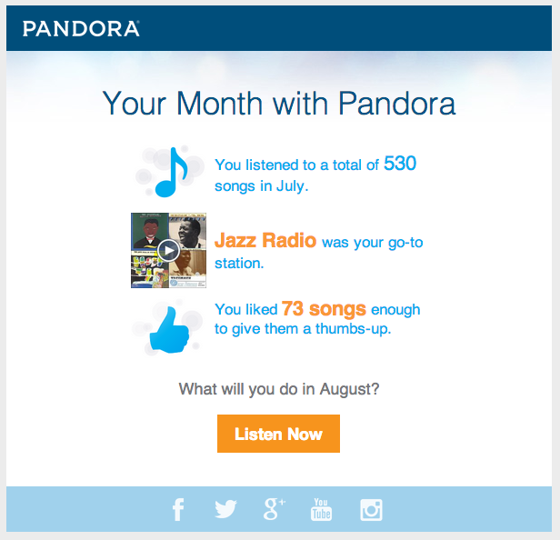
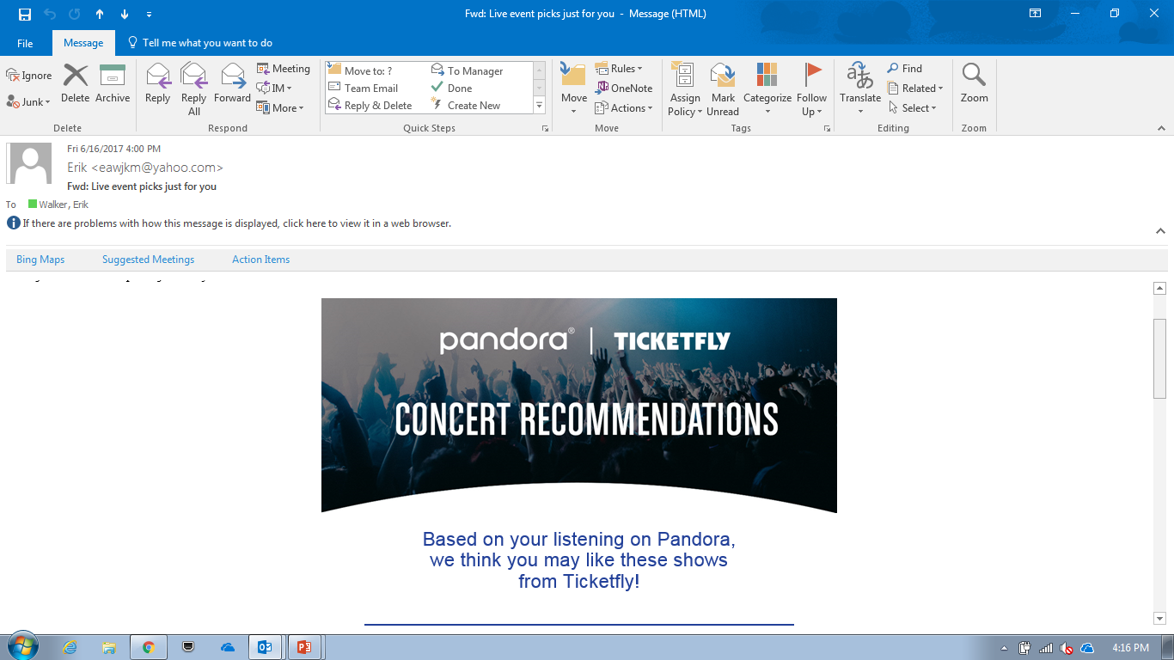
Pandora creates a personalized listening experience by matching musical content to listener preferences
Feedback
(Peering/ Customization)
Mode/ Mood Targeting
Music Genome
(Content Filtering)
Profile/ Event Targeting
Personalized Content

Slide 16
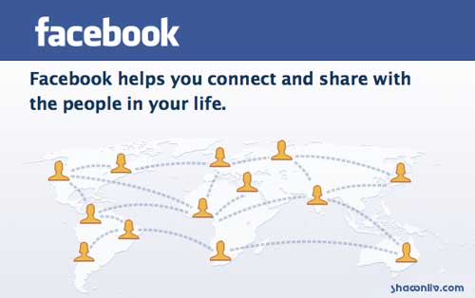
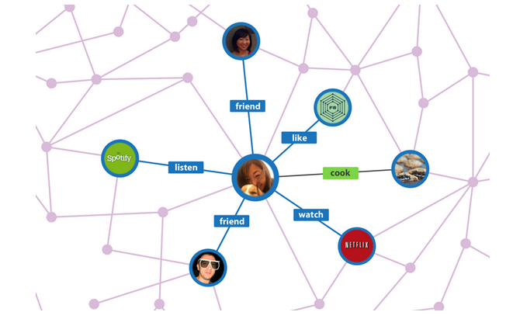
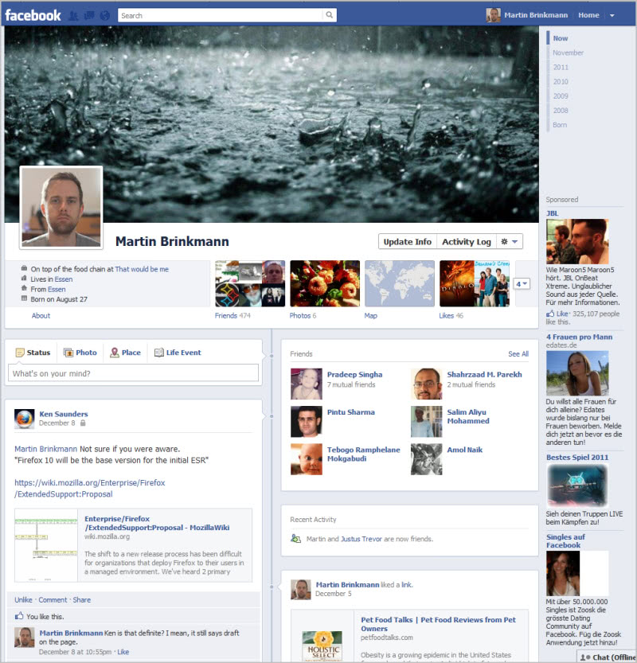

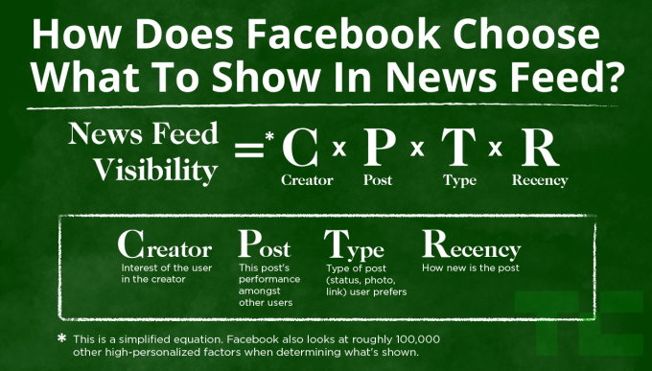
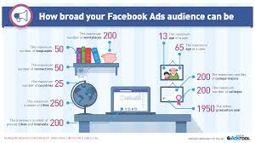
Facebook creates a personalized social experience and ad platform by understanding how a person identifies oneself and connects with others
Social Graph
Profile
Feedback
Personalized Newsfeed
(EdgeRank + Customization)
Personalized Ads
(Ad Match (ML) + Lookalike Audience (Profiling))

Slide 17
Amazon builds personalization throughout the entirely of its
shopping experience
Personalize Queues
Simplify Purchase
Keep Customers Informed
Reinforce Value
Collect Feedback

Slide 18
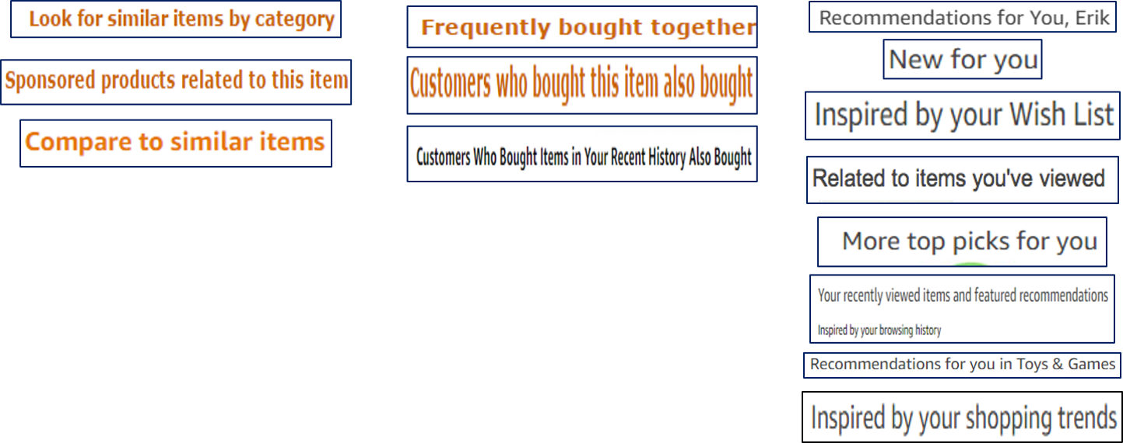
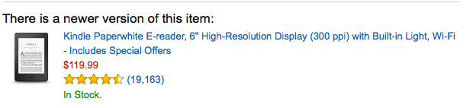
Amazon creates personalized queues by understanding product similarities and aligning them to shopping needs
Content-Based
Recommendations
Peer-Based
Recommendations
Contextual/ Personalized
Recommendations
Driven by several 100’s collaborative filtering models
(peer/ content)

Slide 19
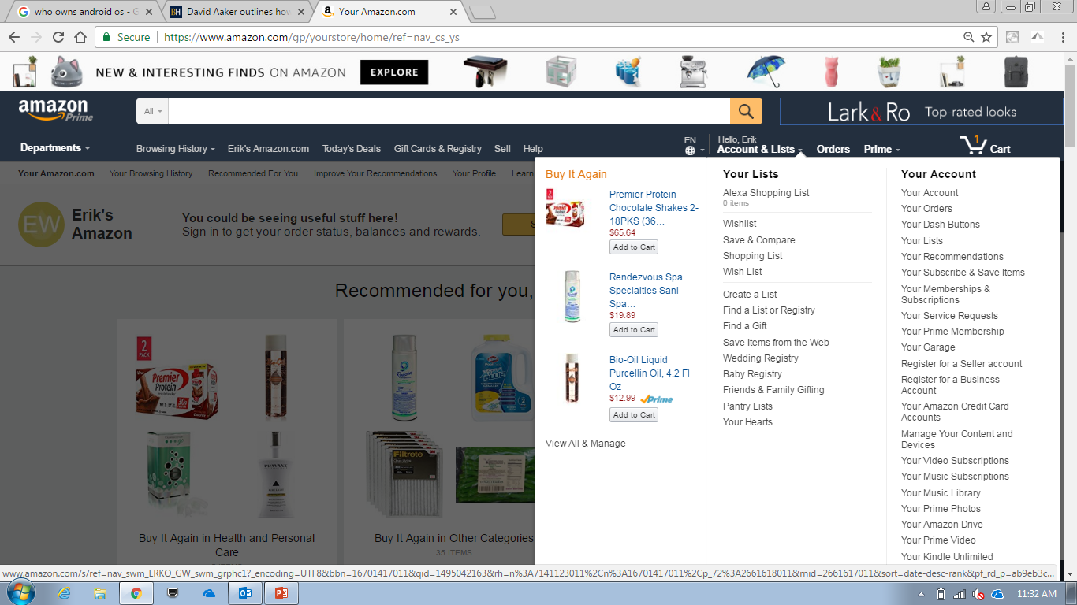
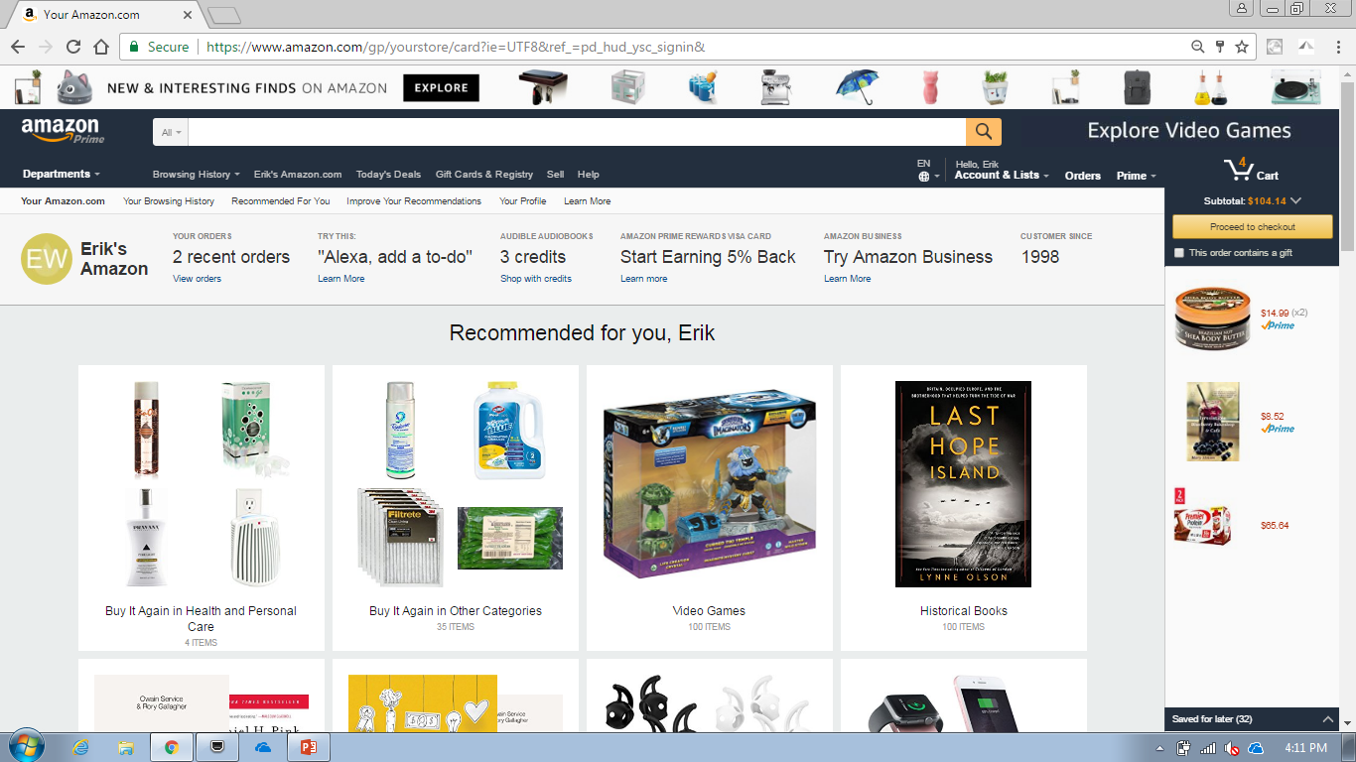
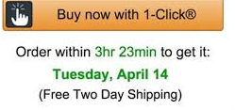
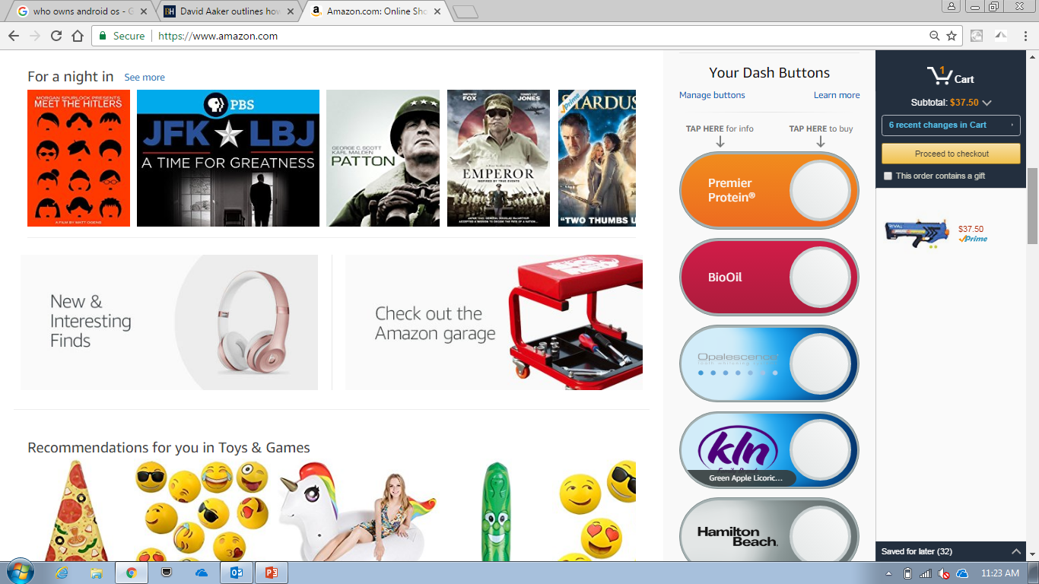
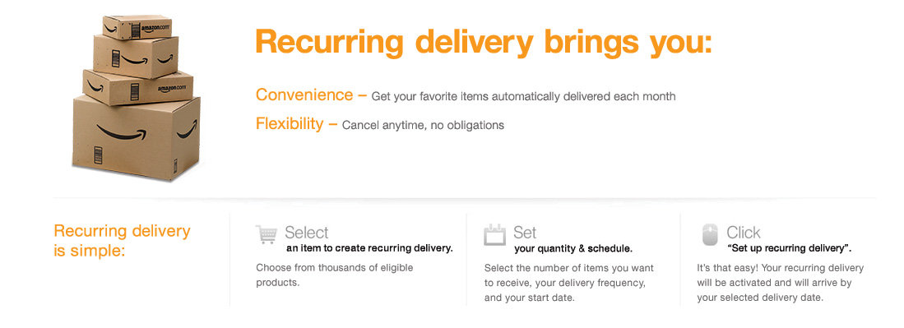
Amazon uses past purchase info to streamline the buying process

Slide 20
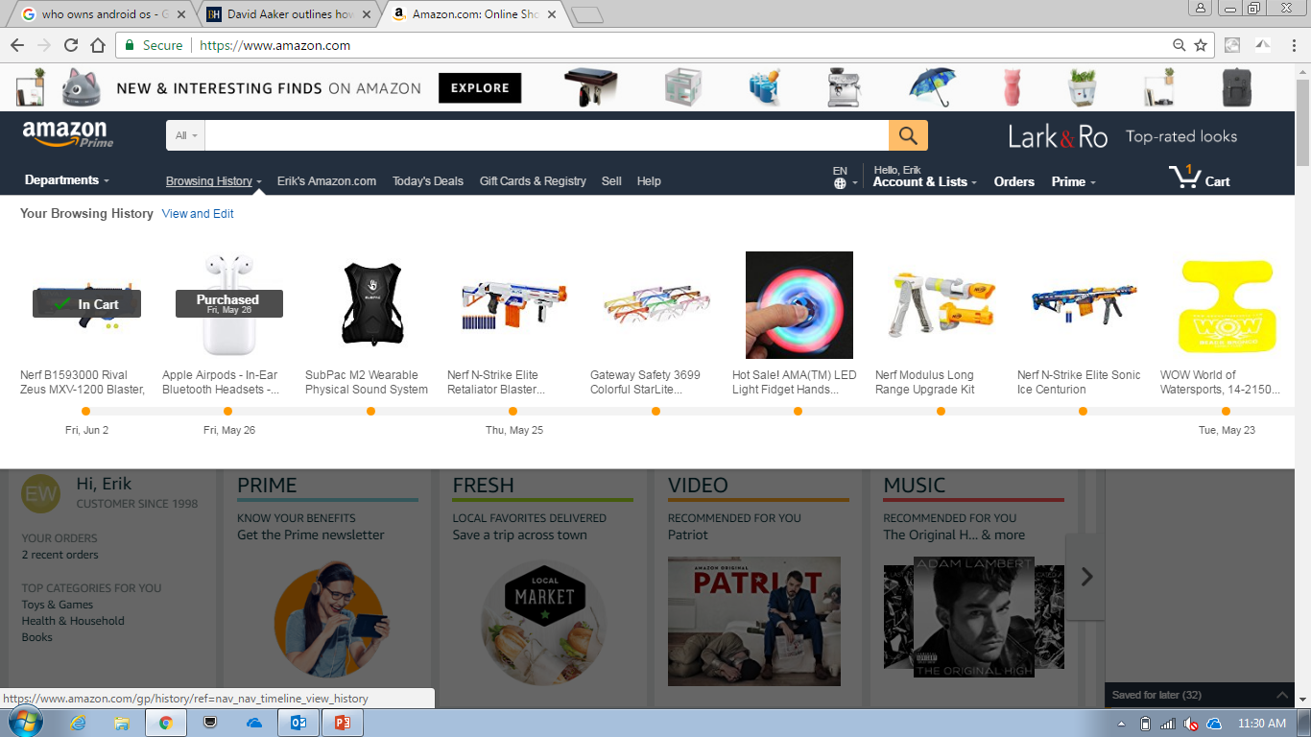
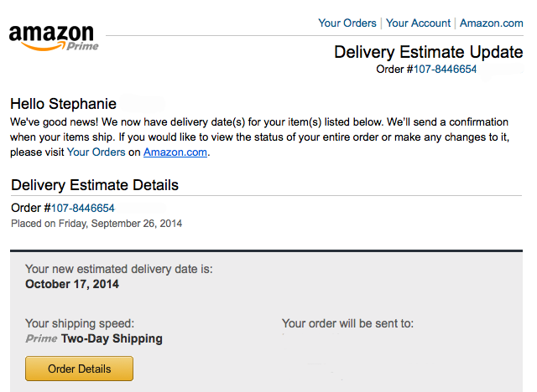
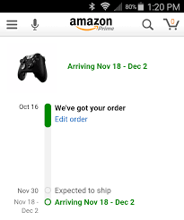
Amazon keeps customers informed from the what they’ve seen to what they’ve ordered
Rich Mobile Tracking Alert

Slide 21
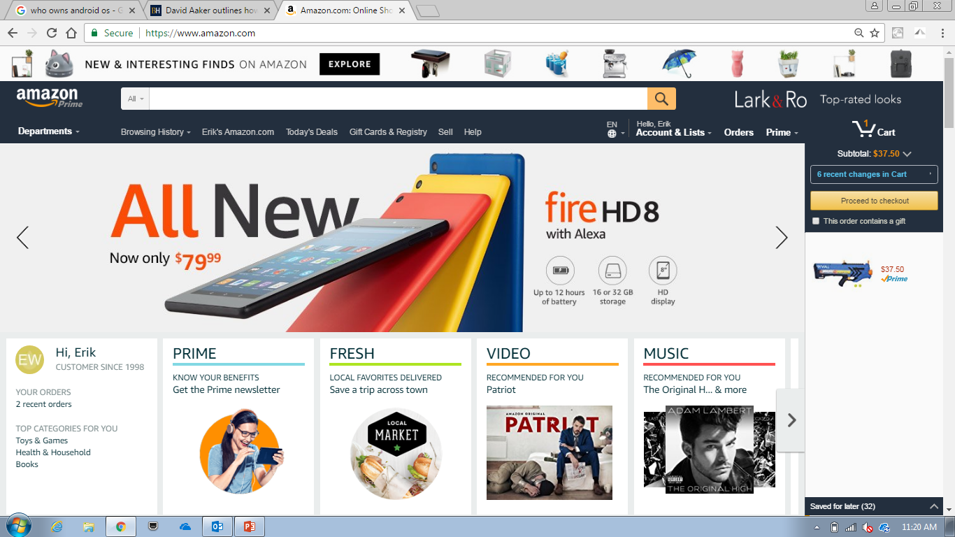
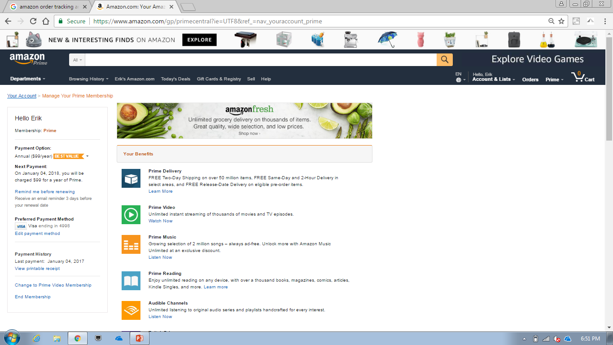
Amazon uses personalization to show the customer where they are getting value

Slide 22
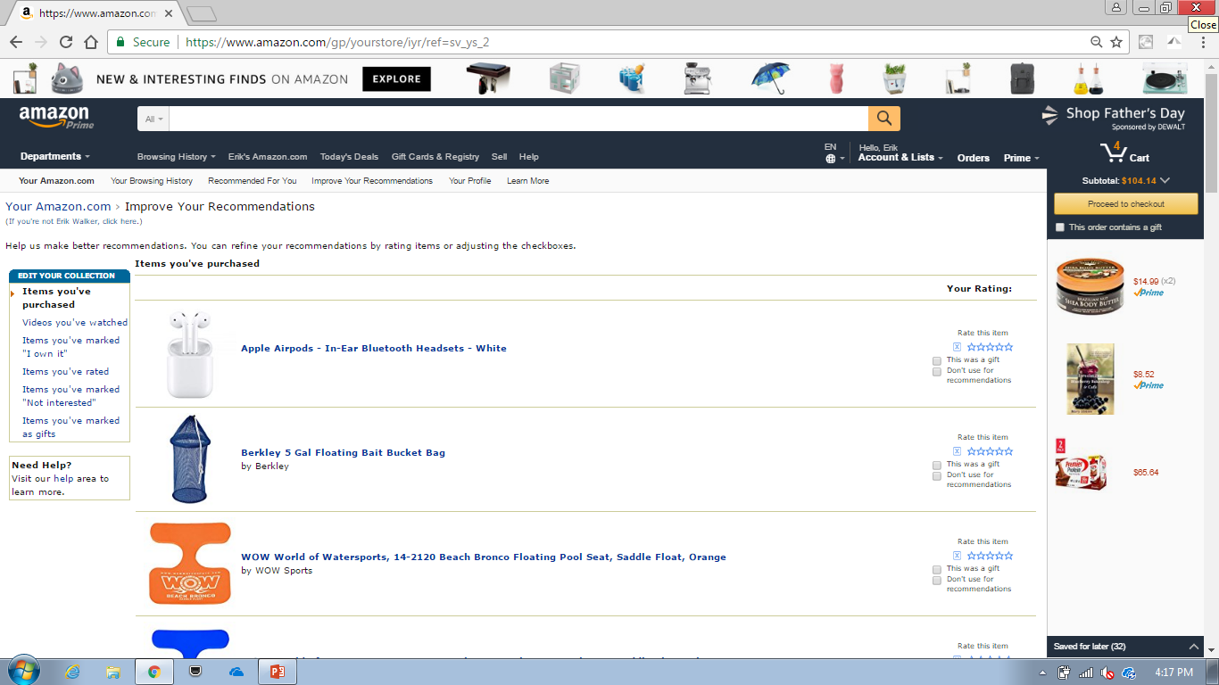
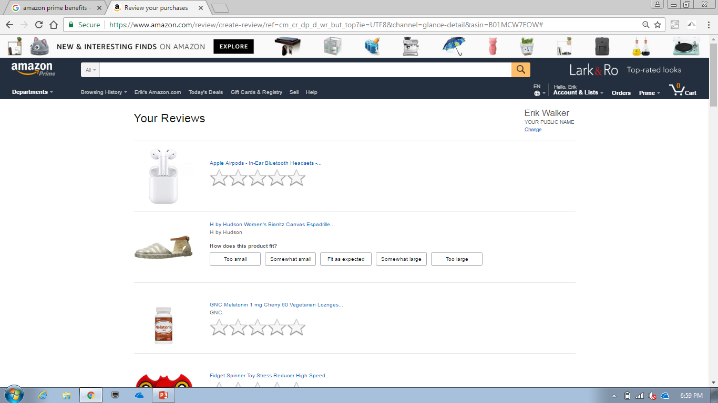
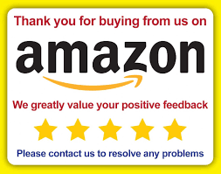
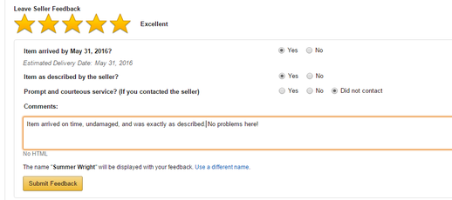
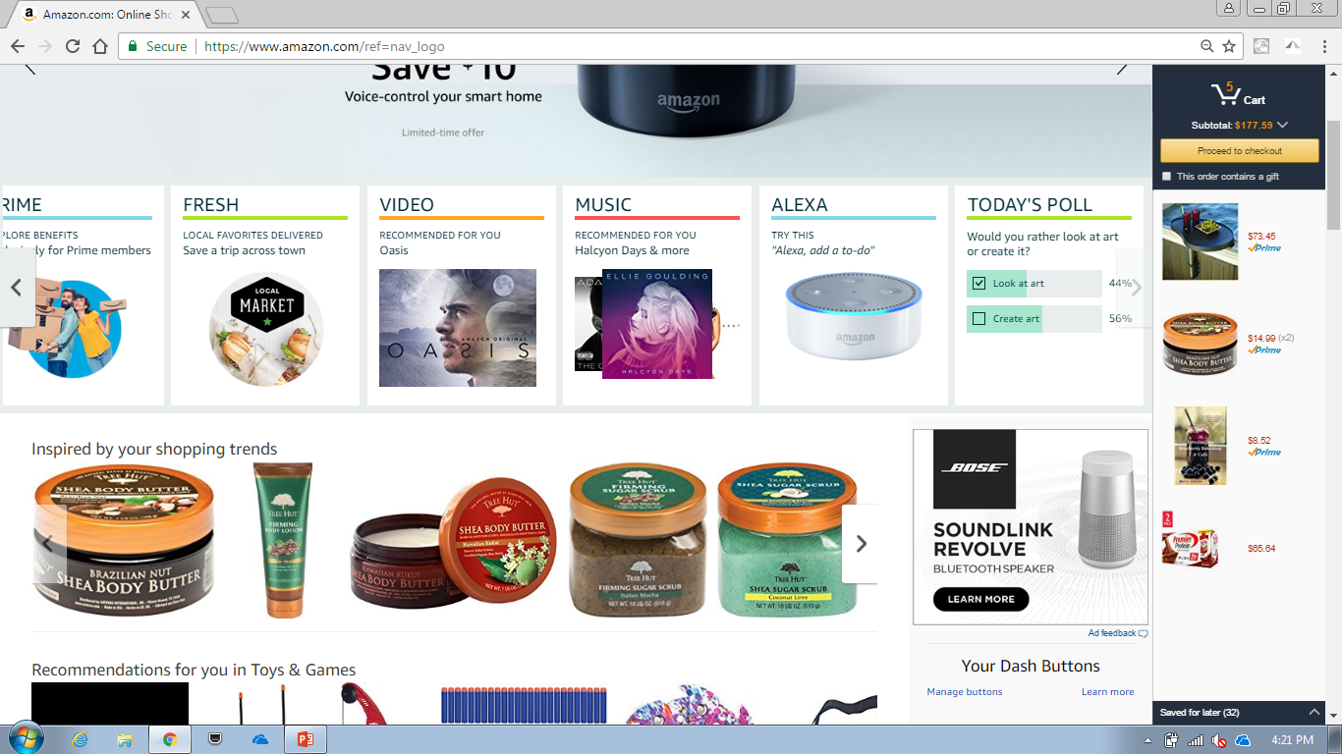
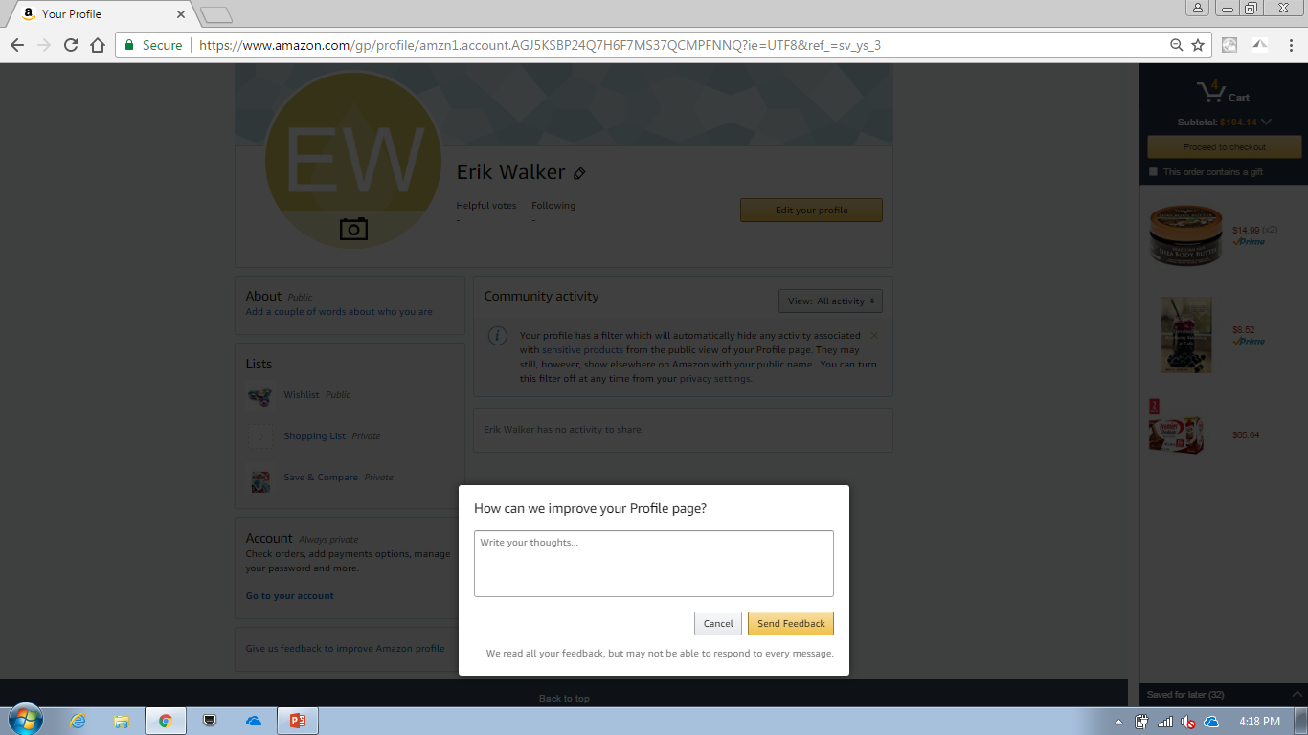
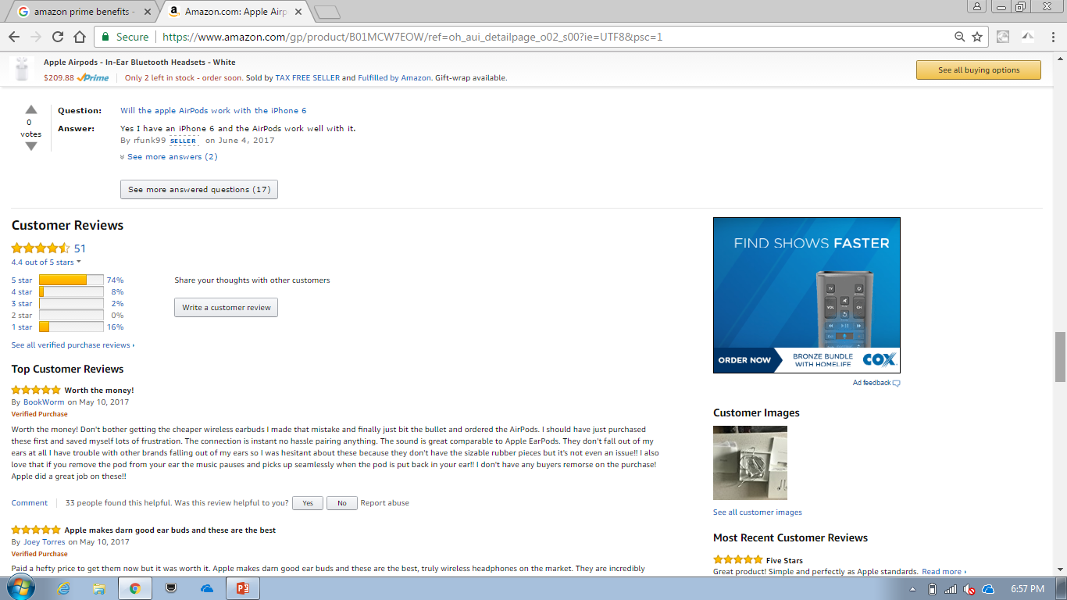
Amazon also collects customer feedback wherever they can to learn about the customer to improve and personalize the experience

Slide 23
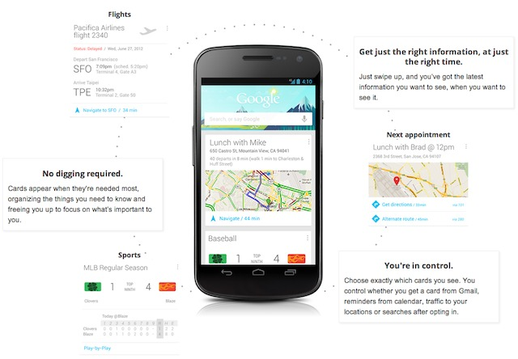
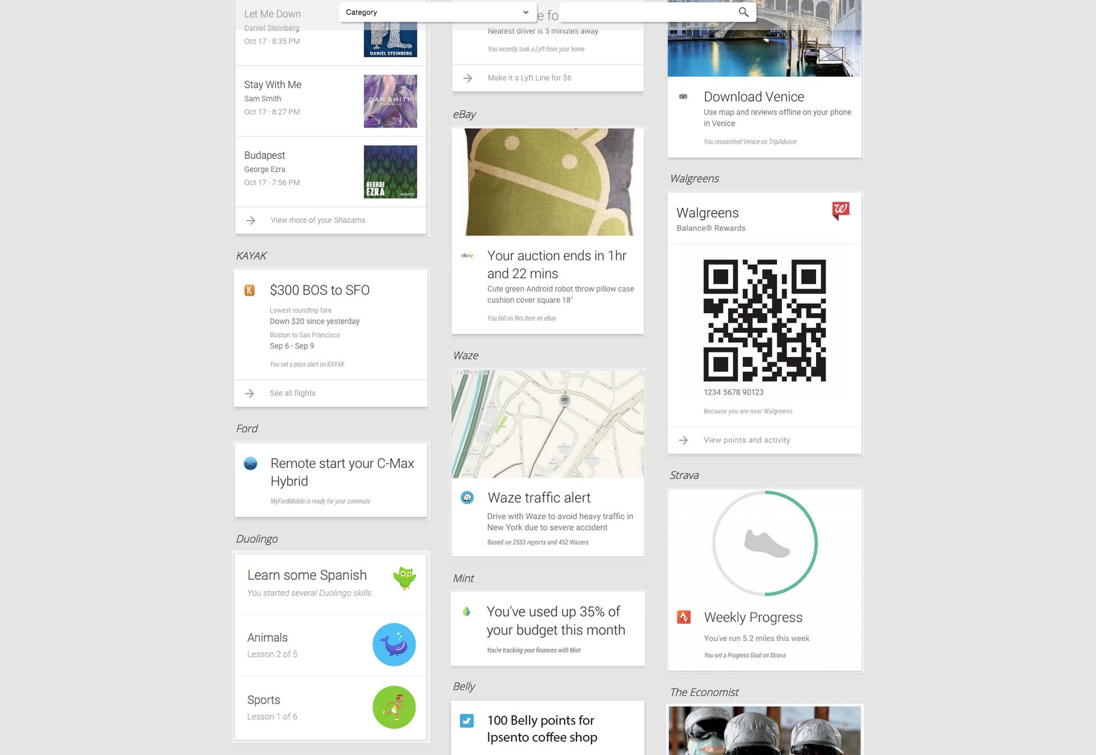
Google Now provides highly contextual information by bringing “just the right information, at just the right time”
Contextual Tools & Info
3rd Party “Cards”

Slide 24
Google Now is an ecosystem of connected data, content & tools, and predictive modeling that delivers highly contextual information
Connected Data
Google Now Platform
Personalized UX
Proactive
Customer Data from Google Products
(Search, Gmail, Photo, YouTube, Maps, etc.)
Customizations
Insights –
Commute Time, Weather, etc.
Predictive Models
Reminders -
Calendar, Travel, Alarm, etc.
Mobile
(GPS, Apps, Android)
Google Search
Google Assistant
Content
(Google & 3rd Party Feeds)
Customer Feedback
(Helpful/ Not)
Google Integration: (Maps, Nest, Android, Play, etc.)
Reactive
3rd Party Apps Data
Search Results
3rd Party Cards/ Apps
Voice Commands

Slide 25
Personalization is designed to drive engagement that delivers measureable and sustainable business outcomes
Revenue
Savings
Loyalty
Brand, Product, & Digital Engagement
PERSONALIZATION

Slide 26
The business opportunity for personalization is wherever we can identify an engagement gap
Brand Engagement
Product Engagement
Digital Engagement
Customers don’t trust COF/ feel COF knows them
Customers are not aware of all of their account benefits and how/ when to use them
Customers are under-utilizing our digital channel and features
Customers become less satisfied with COF over time (NPS)
Customers are not sure what products will best meet their individual needs
Customers are not responding to our digital campaigns/ messages
Customers are only giving a small part of their business to COF
Customers need help avoiding mistakes and making progress
Customers switch channels for context (understanding & status) or when they get stuck

Slide 27
Our customers are ready for personalization
Customers know and generally trust FIs with their data, but asking for data requires more transparency to ensure it is for their benefit
Customers are increasingly comfortable with sharing data, but there are personas that never will be
Customers already expect FIs to use the data they have to better serve them and generally feel protected (servicing needs)
Customers do not feel FIs know them or use their data to help them make smart decisions or grow (financial needs/ trust)

Slide 28
Personalization is mission-aligned
Company Mission
Change Banking for Good
Digital Mission
Capital One is a leading digital company
Technology Mission
Capital One is a leading technology company
Personalization is customer-centric
Personalization will drive digital innovation and engagement
Personalization will require cutting edge technology

Slide 29
Before we make any meaningful commitment to Personalization, we should consider some of the risks
Personalization will require large scale commitment to be effective
Personalization is hard to get right – will be a journey
Customers may not really want it – utility is fine

Slide 30
Compared to digital pioneers, we are far behind in our personalization capabilities
Current State
No Personalization Strategy
Batch Segmentation
Rule-Driven Decisioning
Limited Use of Predictive Models/ Machine Learning
Fairly Static UX
Limited Content
Channel-Specific
No Integrated Customer Data
Digital Leaders
Personalization Business Model
Real-Time Targeting
Model-Driven Decisioning
Highly Evolved ML Models Running at Scale in Real-Time
Fairly Dynamic UX
Large Content Inventory
Omni-Channel Platform
Connected Customer Data
Investment

Slide 31
How do we approach Personalization?
…in the context of EASE but extendible to other channels.

Slide 32
EASE will integrate both customer and business needs into a cohesive personalized experience
Customer Need
Business Need
Needs-Based Content
Best Expected Benefit Decisioning

Slide 33
We will need a Personalization Framework to guide us along this journey
Personalization Strategy
What needs can we address?
Business Needs
Playbook
Customer Needs
Personalization Approach
What is required to address the needs?
CX
Data
Decisioning
Needs-Based Content
Real-Time Customer Context
Best Expected Benefit
Machine Learning
How do we optimize?
Insights
Propensity
Response

Slide 34
The Personalization Strategy seeks to align business needs to customer needs using a Playbook
Personalization Strategy
What needs can we address?
Business Needs
Playbook
Customer Needs
Personalization Approach
What is required to address the needs?
CX
Data
Decisioning
Needs-Based Content
Real-Time Customer Context
Best Expected Benefit
Machine Learning
How do we optimize?
Insights
Propensity
Response

Slide 35
Our Personalization Strategy will focus on the main “know me” needs customers have of their banks
KNOW ME, MY SITUATION, & GOALS
Protect Me
Help customers stay informed & avoid mistakes
Guide Me
Help customers improve, grow, & achieve goals
Reward Me
Help customers get value & feel valued
Keep my data and money safe
Proactively warn of an upcoming or potential event
Highlight unusual activity or changes in spending patterns/ bills
Keep me informed on issues
Advise how to avoid fees/ penalties
Reinforce positive behavior
Provide financial guidance (short/long)
Suggest services that benefit me
Highlight value received from account benefits
Highlight value from digital features
Acknowledge customer loyalty and value
TRUST, LOYALTY, & ENGAGEMENT

Slide 36
Personalization will match a customer need to a “solution”
Status &
Help
Protect
Me
Offers &
Advice
Benefits &
Appreciation
Personalization
Strategy
Guide
Me
Reward
Me
Solution
Need

Slide 37
The solution also supports an underlying business objective and measurable business result
Solution
Objective
Result
Brand Engagement
Retention
Satisfaction
Status &
Help
Revenue
Offers &
Advice
Benefits &
Appreciation
Product Engagement
Awareness benefits
Use of benefits
Savings
NPS
Digital Engagement
Reliance on Digital
Use of Digital features

Slide 38
The Personalization Playbook is a repeatable process that will allow us validate, scale, and automate needs-based solutions
KNOW ME, MY SITUATION, & GOALS
Protect Me
Guide Me
Reward Me
PERSONALIZATION PLAYBOOK
Context
Identify Actionable Segments/ Needs
Map Journeys & Events
Define Targeting Strategy (Attributes/ Models/ Placements)
Content
Define Solution (Content, Tools, UX)
Source/ Build Solution
Validate Solution (Research/ Content Test)
Conversion
Define Test & Objectives/ KPIs
Run Experiment/ Measure Result
Learn & Refine
Scale/ Automate
Research & Analysis
Design Thinking
Test & Learn

Slide 39
The Personalization Approach will evolve and integrate the key components needed to support the strategy
Personalization Strategy
What needs can we address?
Business Needs
Playbook
Customer Needs
Personalization Approach
What is required to address the needs?
CX
Data
Decisioning
Needs-Based Content
Real-Time Customer Context
Best Expected Benefit
Machine Learning
How do we optimize?
Insights
Propensity
Response

Slide 40
Our CX approach will be to integrate personalized content into the EASE experience as we shape it towards a future state
KNOW ME, MY SITUATION, & GOALS
Protect Me
Help customers stay informed & avoid mistakes
Guide Me
Help customers improve, grow, & achieve goals
Reward Me
Help customers get value & feel valued
Keep my data and money safe
Proactively warn of an upcoming or potential event
Highlight unusual activity or changes in spending patterns/ bills
Keep me informed on issues
Advise how to avoid fees/ penalties
Reinforce positive behavior
Provide financial guidance (short/long)
Suggest services that benefit me
Highlight value received from account benefits
Highlight value from digital features
Acknowledge customer loyalty and value
PERSONALIZED CONTENT
Augment security features and account alerts with:
Event Updates/ Trackers
Contextual Help & Insights
Proactive Alerts
Augment onboarding/ digital campaigns and help with:
Contextual Recommendations
Contextual Help & Insights
Profile & Goal Building
Generate awareness of COF benefits and customer appreciation by:
Benefit Awareness/ Tracking
Customer Appreciation/ Humanity
Change Banking For Good Stories

Slide 41
Understanding the customer’s Context is critical for identifying the need
Context
Need
Solution

Slide 42
Our Data approach will be geared towards creating a real-time Customer Context that allows us to identify and target needs
Personalized UX
Profile
Events
Location
GPS
Predictions
Patterns
Preferences
Account
Need/ Interest
Events
Channel/ App
Page/ Step
Customer/ Account Info
Customer
Business
Goals
Success/ Fail
Decisioning
Right Content
Right Place
Right Time
Need
Real-Time Customer Context

Slide 43
Decisioning consists of three main processes
1
2
3
Qualification
Scoring
Arbitration
Rule-based
Customer & account
Touch (channel, placement, frequency, feedback)
Predictive
Propensity of need
Likelihood of response
Rank ordering
De-confliction
Relevance threshold

Slide 44
Decisioning will incorporate both customer need for relevance and business need for benefit to deliver optimized results
Relevance
Urgency
Propensity
Benefit Index
PV
NPS
Best Expected Benefit
Awareness
Conversion
Response
Engagement

Slide 45
We will arbitrate across a variety of factors to determine relevancy
RELEVANCE FORMULA
Rule
Urgency
How important is the content to be seen in this interaction?
Right Content
Right Place
Right Time
Predictive
Propensity
How likely is this customer to need/ be interested in the recommendation (action, feature, product, advice, help)?
Response
How likely is the customer to respond to the content in a given placement, considering previous impressions?

Slide 46
An holistic approach to measuring response and assessing business value will be required to optimize
RESPONSE MEASUREMENT
Collect
Engagement (Click, scroll)
Conversion (do/ use, enroll)
Analyze
Response Rate
Moving Average
Value
Business Benefit Index (PV + NPS)
Sentiment (helpful/not, dismiss/ no thanks)
T-C Lit
Monthly Growth Rate
Penetration Rate
Direct & Indirect Attribution

Slide 47
Machine Learning will support Personalization by identifying & predicting needs and optimizing response
Personalization Strategy
What needs can we address?
Business Needs
Playbook
Customer Needs
Personalization Approach
What is required to address the needs?
CX
Data
Decisioning
Needs-Based Content
Real-Time Customer Context
Best Expected Benefit
Machine Learning
How do we optimize?
Insights
Propensity
Response

Slide 48
Machine Learning will be necessary for Personalization given a variety of factors
Customer needs are highly nuanced
Manual test & learn is slow
Real-time scoring & decisioning is required
Optimization requires continuous learning

Slide 49
Machine Learning will deliver Best Expected Benefit by predicting customer needs (propensity) and content response
Customer Qualification
Real-Time,
Batch Segmentation
Governance
Rules
Touch Rules
Channel, Placement
Frequency, Feedback
Priority
Urgent Servicing/ Biz Need
Required (Regulatory, etc.)
Best Expected Benefit
Likelihood to Convert X Benefit Value
Machine-Learning
Personalization
Propensity
Conversion Event/ Window
Business Value
Response (Placement/ Frequency/ Layout)
Best Response
Likelihood =
Highest Click/ Conversion
Content Optimization (A/B Testing)

Slide 50
Machine Learning will be used to develop both Insights and Models by creating a continuous learning cycle
Develop ML Insight/ Model
Set Up & Automate Experiment
Capture Response & Feed Models
Analyze Response & Optimize ML Models
1
Learning
Hypothesis
4
2
Response
Interaction
3
Notes:
1 https://www.forester.com/report/Advance+To+NextGeneration+Personalization/-/E-RES80681

Slide 51
Propensity and response ML models will improve by being trained by customer response
Login (SSOID)
Customer Context
Client + API + Propensity+ Segmentation Data
Qualification Engine
Machine Learning
(Response)
Qualified Campaigns &
Predictive Data
Click, Conversion, Feedback
Apply campaign rules
(customer/ account, touch)
Propensity
Scores
Predictive Data
Response Optimization
Channel/ App
Page
Placement
Frequency (planned)
Style/ Layout (planned)
Propensity (planned)
Propensity (Planned)
Use (Feature)
Need (Feature)
Buy (Product)
Call (Event)
Likelihood & Benefit Scores
Machine Learning
(Propensity)
Arbitration/ Decisioning
Rank By Placement:
Priority
Best Expected Benefit
Best Response
Click, Conversion, Feedback

Slide 52
What does EASE Personalization look like?
…and how do we start to pursue it?

Slide 53
Personalized EASE UX Concept

Slide 54


We have combined two enterprise platforms to enable a Personalization agenda
Enterprise Customer Platform
Customer-Centric Design
Dynamic Placements
Features + Deep Links
Marketplace & Insights
Alpha/ Beta Releases
NPS & Surveys
Interactive Content
Enterprise Decision Engine
Customer & Account Targeting
Channel & Placement Targeting
Batch & Real-Time Targeting
Multi-Objective Arbitration
Automated Multivariate Testing
Propensity/ Response ML
Campaign Management
Nescient

Slide 55
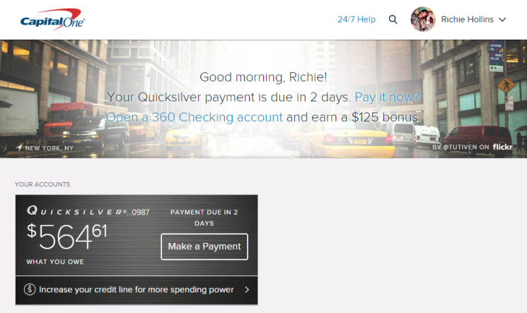
Harmony is currently driving several key placements within EASE
Customer Messaging
Account Action
Offer
(Planned)
Account Messaging (L1 & L2)

Slide 56
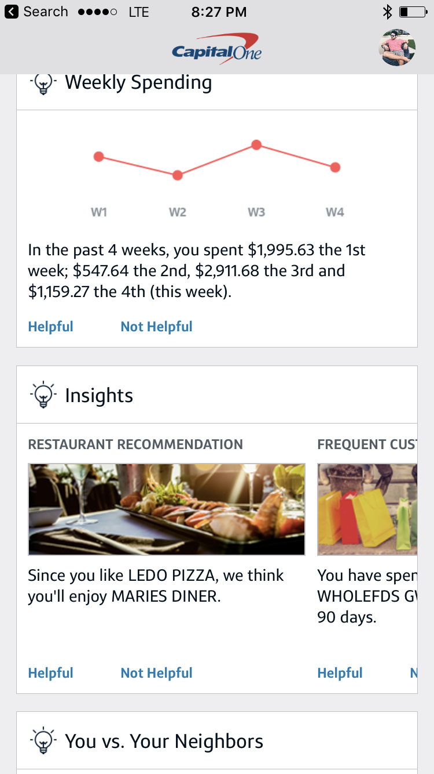
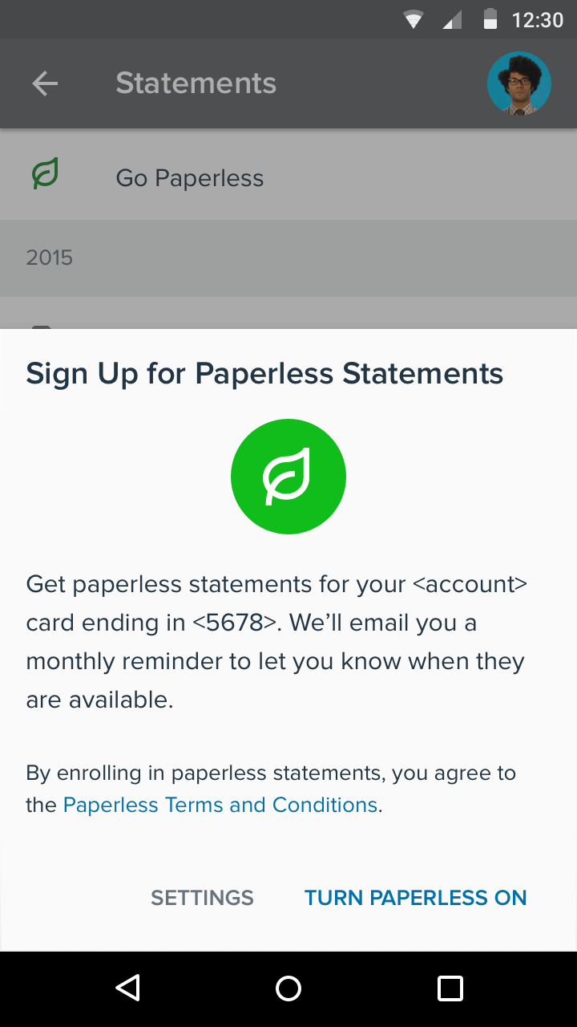
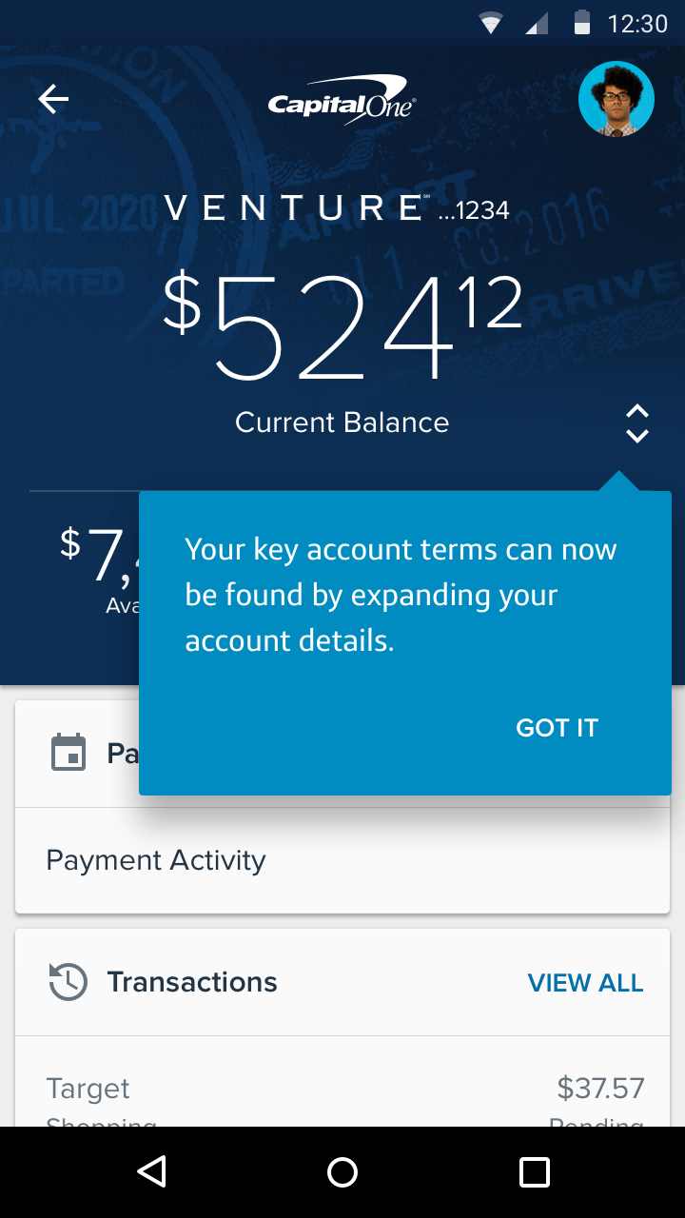
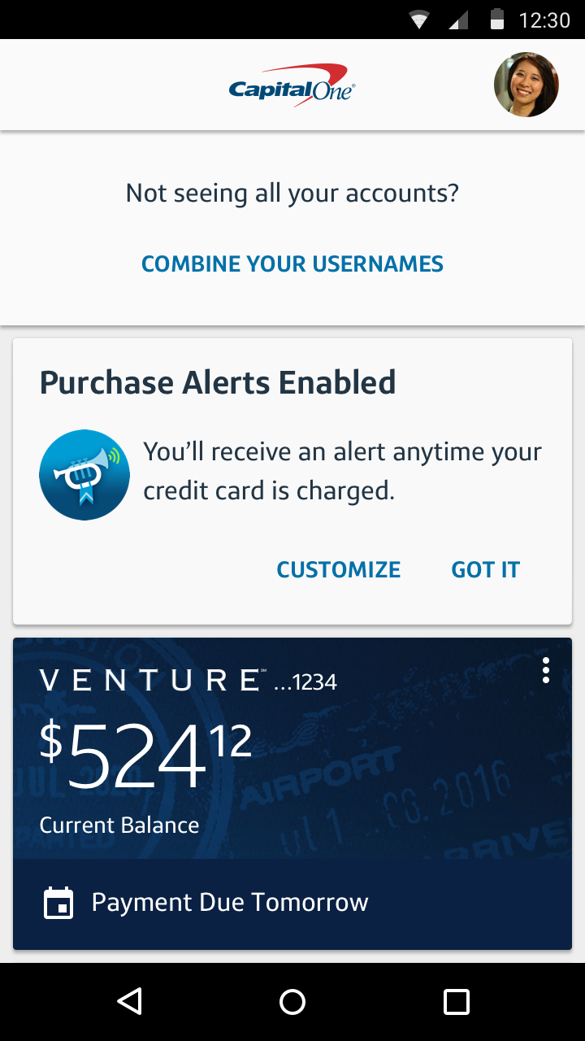
In addition, EASE Mobile has been testing some dynamic capabilities that can support the Personalization agenda
Insights Personalized content feed
Slide Ups Contextual content
Hints Feature awareness
Tiles
Moveable content
Will require aligning & scaling across iOS & Android

Slide 57
We are also putting together a multi-faceted team to drive the
EASE Personalization agenda
Personalization Strategy
UX & Content
Data Science
Campaign Mgmt
Harmony Platform
Data Analytics

Slide 58
A Personalization “Center of Excellence” across EASE, LOB, & Tech could allow us to accelerate our journey
Features & Content
Qualification & Events
Conversion & Value
Needs & Insights
LOB
Context
(Harmony)
Campaign/ Content Mgmt
(Harmony)
Decisioning & Machine Learning
(Harmony)
UX
(EASE/ Channel)
Tech
EASE
UX, Content, & Features
Campaigns & Learnings
Capabilities & Tools
Needs & Insights
Digital
ECI
Eno
Gumbo
The Site
Wallet

Slide 59
We will start our Personalization journey in Mobile and focus primarily on Consumer Card business needs
Strategic Drivers
Most Engaged Customers
Most Connected Customers
Most Customer Growth
Card vs LOB size
Mobile vs. Web Behavior
X have notifications On
X have GPS On
Mobile channel growth – overall and COF
Business Objectives
Reduce Mobile Defectors
$XM Savings Opportunity
Increase Mobile Revenue
$XM Revenue in 2016
Improve Mobile NPS
ioS X/ Android Y
Reduce Average Call Rate per Session
Increase Average Revenue Per Mobile User
Increase Mobile Engagement
KPIs

Slide 60
The Personalization Approach will be dependent upon our ability to execute on several strategic objectives
Personalization Strategy
Reduce Mobile Defectors
Reduce calls within 2 hours of Mobile session
Increase Mobile Revenue
Drive lift in NABs and PV feature engagement
Improve Mobile NPS Drive lift in NPS & Mobile engagement
Target top call reasons
Define deflection KPIs
Track event states/ steps
Streamline Sales funnel
Cultivate targeting data
Create offer inventory
Measure NPS/ sentiment/ feedback
Inventory product/ feature benefits
Build Brand presence/ humanity
Personalization Approach
Protect Me
Help customers stay informed & avoid mistakes
Guide Me
Help customers improve, grow, & achieve goals
Reward Me
Help customers get value & feel valued
Proactive & Contextual Help
Event Status, Help
Call Deflecting Feature Awareness/ Onboarding
Contextual Feature Recommendations – e.g.
Alerts, AutoPay, CW
Insights – e.g.
Counters (fees, late payment)
Spending and balance shifts
People who…
Profiling
Goals, Surveys, Content Mktg
Contextual Feature Recommendations – e.g.
Card, BT/ CLIP, CW, AutoPay
Insights – e.g.
Goal progress
Positive pattern/ trend
People who...
Product benefit awareness
Brand/ Humanity campaigns
Insights
Account benefit tracking
Customer successes
Since you have been a customer…
People who…

Slide 61
Personalization will become increasingly effective as we mature our data capabilities and content
Context
Limited real-time data via APIs
Content
In-market EASE features (incl. deep links)
Conversion
Automated batch segmentation (TBD – EDS Funding)
Batch scored propensity models
Product & Help Content
No real-time conversion
Manual conversion tracking
No conversion data feeding ML
LOB & Digital campaigns
Target
Real-time state, event, and scoring
Robust inventory of features, tools, and needs-based content
Real-time conversions feeding ML models and dashboards

Slide 62
We will need incremental investment to move beyond very basic experimentation
Current
Incremental
Harmony
(40% Feature/ 60% Support)
EASE
(TBD)
EDS
Auto-segmentation Ops
Event/ conversion mapping
Build context
Content delivery
Campaign management
Campaign response
Arbitration
Machine Learning
Production Monitoring
Build dynamic placements
Request content
Display content
Track campaign
Capture response
Deliver context/ events
Production Monitoring
Data Engineering
Expand customer context
Collect response/ conversion data
Source, transform, load data
Invest
2 Teams
(1) API + DevOps
(1) Engine + DevOps
1 Team
Mobile (iOS/Android)
incl. 1.5 Edge + DevOps
Data Science Engineering
Predictive (Python) APIs
Deliver Insights
QE + DevOps
EDS
Mobile
Accelerate iOS/ Android
Build/ fix deep links
CAL/ Events
SiteCatalyst/ Potomac
CAL/ Events
SiteCatalyst/ Potomac

Slide 63
We will continue to make progress on Personalization capabilities as we await key enablers
Harmony
Scale Epiphany (AWS)
Enforce Placement & Campaign Governance
Implement Propensity & Response Models
EASE
Fully Integrate Harmony
Expand & Enhance Dynamic Placements
Build Personalized UX
Machine Learning
Build Propensity Models & Needs Context
Develop “Conversion Factory” & Audience Discovery Tools
Develop Insights

Slide 64
We will require additional funding to pursue broader agendas
CRITICAL
Replace Epiphany
Integrate Other Channels
Leverage External Data
Not a leader in the space (no longer in Gartner Magic Quadrant/ not core focus of Infor’s business
Not ideal for AWS deployment
Requires Oracle license
“Blackbox” ML designed for response optimization, not propensity
Not easy to federate/ self-service
Some functionality limitations
The Site – Leverage Harmony/ Context to drive relevancy for customer offers
Gumbo – Integrate Gumbo and Harmony campaigns/ history
Eno – Leverage Harmony for predictive content/ context
Aggregation– Expand targeting relevance and predictiveness via externally aggregated account data.
3rd Party – Incorporate customer profiling data useful for targeting (e.g. demographic/ socioeconomic, financial, lifestyle/ attitudinal)

Slide 65
Although primarily reliant on batch data, we can start to execute on our Personalization Journey to develop some learnings
Generate Actionable Insights
Run Personalization Experiments
Build & Train Propensity Models
Personalization Learnings
Measurable Business Results
More Optimized Models

Slide 66
Personalization Roadmap
Phase 1 (EOY ‘17)
Run Playbook
Identify opportunities & execute batch-based tests (content, models)
Phase 2 (EOY ‘18)
Build Harmony 2.0
Replace Epiphany with target solution - campaign rules, arbitration, and machine learning (response, multivariate)
Phase 3 (TBD)
Streaming & Scoring
Implement real-time event streaming
Develop measurement & valuation for campaigns -> dashboards
Build partnerships and processes (governance, test & learn)
Develop target platform architecture -> scale, self-service, federation
Run ML scoring/ targeting and response optimization at scale
Expand Personalization/ Harmony beyond EASE

Slide 67
While EASE campaigns have shown results, we will need to develop more proof points for our Needs-Based approach to Personalization
Needs-Based Content
Event Targeting
Placement Targeting
Propensity Targeting
Profile Targeting
Card Activation Learnings
Cross-Sell Learnings

Slide 68

We will need to test how Needs-Based Content performs relative to more broadly-purposed and targeted content
Current Approach
Personalization Approach
Total Qualified Customers
Total Qualified Customers
Segment A
Segment B
Segment C
Content A
Content B
Content C
Need A
Need B
Need C
A/B testing identifies winner(s) that all qualified customers get
Content A
Content B
Content C
Content geared towards more universal needs (e.g. save time)
Content geared towards more specific needs (e.g. since you recently/ this happened…)
Content is presented based upon campaign touch rules
Content is presented when there is detection of a need (e.g. propensity/ event) for any qualified segment

Slide 69
We developed some initial Personalization learnings with
Card Activation
Needs-Based Targeting
Event Targeting
Placement Targeting
Propensity Targeting
Profile Targeting
Card Activation Learnings
Cross-Sell Learnings

Slide 70
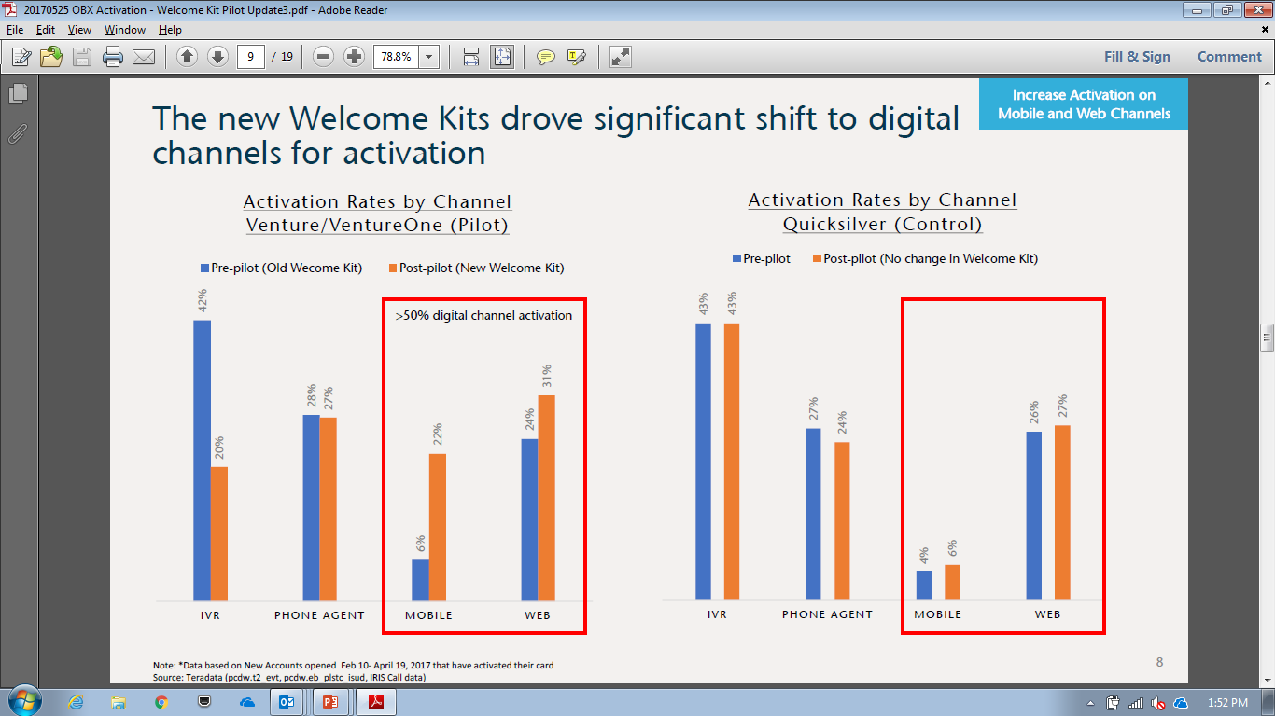
Result: Messaging customers to activate their Card upon login has generated measurable business results
Card Activation Campaign Performance
12/8/2016 – 1/19/2016
EASE Mobile
COS
Both
7%
fewer
calls
Welcome Kit + Messaging increased digital Card activation rate > 50%
Messaging drove conversion >35% with lift of X
$X annual OpEx savings
Footnotes and disclaimers
Notes:
Card Activation Campaign Performance Source: EDW, SiteCatalyst
Notes: Rates reflect # of customers clicking/converting in a given day divided by the sum of daily unique customers; Conversions reflect customers who activated new card on EASE/COS within same day of viewing message (SiteCatalyst tags ‘Card Activation:Successful Activation’ on iOS, Card Activation ‘success’ on Android, ‘card activation:card activation success‘ or ‘card activation:complete‘ on COS); Conversions attributed to actual channel of conversion

Slide 71

Placement Learning: Customers notice certain account-related information nearest to the context of their account
Card Activation Performance by Placement
EASE Mobile; 12/8/2016 – 1/19/2016
Card Activation Performance: Both Placements
EASE Mobile; 12/8/2016 – 1/19/2016
Click Rate
Conversion Rate
Customer Reach:
Views:
224K | 146K | 178K
469K | 416K | 597K
AM
CM
Both
Source: EDW, SiteCatalyst
Notes: Rates reflect # of customers clicking/converting in a given day divided by the sum of daily unique customers; Conversions reflect customers who activated new card on EASE within same day of viewing message (SiteCatalyst tags ‘Card Activation:Successful Activation’ on iOS and Card Activation ‘success’ on Android); Conversions attributed to message(s) customer clicked on; Views reflect unique page views (ex: a customer who views the L1 page with both CM and AM placements would contribute one view); ~5% of customers viewed different combinations of placements on Mobile on different days
Notes:
legend

Slide 72
Placement Learning: Customers switch between Web & Mobile and may have a preference for where they perform certain actions
Card Activation Performance by Platform
12/8/2016 – 1/19/2016
Card Activation Performance: Both Platforms
12/8/2016 – 1/19/2016
Conversion Rate
Click Rate
Customer Reach:
Views:
510K | 568K | 15K
1,450K | 1,570K | 63K
EASE Mobile
COS
Both
Source: EDW, SiteCatalyst
Notes: Rates reflect # of customers clicking/converting in a given day divided by the sum of daily unique customers; Conversions reflect customers who activated new card on EASE/COS within same day of viewing message (SiteCatalyst tags ‘Card Activation:Successful Activation’ on iOS, Card Activation ‘success’ on Android, ‘card activation:card activation success‘ or ‘card activation:complete‘ on COS); Conversions attributed to actual channel of conversion

Slide 73
Placement Learning: Timing of the message related to an event peaks and then falls off
Card Activation Performance by Days Since Request Date
EASE Mobile; 12/8/2016 – 1/19/2016
Conversion Rate
Click Rate
Source: EDW, CDW, SiteCatalyst
Notes: Rates reflect # of customers clicking/converting in a given day divided by the sum of daily unique customers; Conversions reflect customers who activated new card on EASE within same day of viewing message (SiteCatalyst tags ‘Card Activation:Successful Activation’ on iOS and Card Activation ‘success’ on Android); Days Since Request Date calculated as difference between message view date and card request date (existing customers) or account open date (new customers); ~50% of distinct daily customers see the Card Activation message more than 30 days after last request date is recorded in CDW

Slide 74
We have started to experiment with propensity-driven cross-sell
Needs-Based Targeting
Event Targeting
Placement Targeting
Propensity Targeting
Profile Targeting
Card Activation Learnings
Cross-Sell Learnings

Slide 75
We will need to evaluate the impact of using Propensity Modeling to predict needs and improve conversion
Hypothesis: An “always on” offer engine with propensity targeting will drive more conversions than pre-segmented campaigns.
Propensity Curve
Campaign
Pre-qualified offer + De-conflicted segments
Distribution of customers per propensity score
(0 unlikely, 1 very likely)
Segment 1
Offer A
Segment 1
Offer B
# Customers
-VS-
0
0.5
Highly Relevant
1
Always On
Response Curve
Pre-qualified offer inventory + Propensity targeting
1
1-A
1-B
2-A
2-B
1-C
2-D
3-E
Higher propensity should lead to higher conversion
Propensity
0
Conversion Rate
Higher Overall Conversion

Slide 76
Using propensity to display the Product Widget drove X% lift in a small scale test
Outline test
Summarize result
Show propensity/ response curve

Slide 77
Harmony is capturing data to enable us to comprehensively evaluate the impact of our Decisioning strategy and campaign performance
ILLUSTRATIVE
KPIs
Reach: 85%
Win Rate: 65%
Click: 5%
Conversion: 8%
T-C Lift: 5%

Slide 78
Appendix

Slide 79






Digital Banking Report
“The Power of Personalization in Banking”, 2016

Slide 80
There is emerging evidence of more sophisticated personalization in FS
Wells Fargo
ATM screen personalizes options using past ATM behavior
USAA personalized landing page for mobile based upon most commonly used features
USAA invests in CognitiveScale
Mint/ Credit Karma – Personalized insights and recommendations
Intuit TurboTax – Personalized guide with contextual help
Fintech
Moven (Financial Personality)
Digit
ClarityMoney
Bettermint
Personal Capital
Industry Vendor
Personetics
Notes:
https://www.americanbanker.com/news/usaa-strives-for-personalization-in-its-banking-apps
https://www.americanbanker.com/news/personalization-is-focus-of-wells-fargos-new-atm-design
http://finovate.com/alfa-bank-debuts-sense-a-new-way-of-mobile-banking/
https://www.forrester.com/report/Personalization+And+The+Rise+Of+Individualized+Experiences/-/E-RES115794
https://www.americanbanker.com/news/bb-amp-t-lets-customers-build-their-own-online-banking-portal
https://www.americanbanker.com/news/how-googles-personal-assistant-is-influencing-financial-apps
http://bankinnovation.net/2013/04/bank-account-personalization-movens-financial-personality-feature/

Slide 81
Campaign Pre-requisites
Digital Engagement
Revenue
Call Deflection
NPS
Accurate (real-time) qualification/ disqualification
Feature deep-linking
Feature conversion & campaign attribution
Value of digital feature enrollment/ usage
Value of digital engagement/ KPIs
Qualified audience/ offer inventory
Streamlined application hand-off/ UX
Value & attribution of application/ conversion
Multiple offers per customer (no deconfliction)
Propensity model with reliable predictive data (buying mindset)
Content marketing (prospecting)
Real-time context (event, state)
Help content (general)
Feature deep-linking
Deflection analysis & measurement
Granular NPS measurement (session/ interaction/ feature/ content)
Sentiment feedback scoring

